Slide 1


QUANTUM FOURIER TRANSFORM & PHASE ESTIMATION Prof. Amlan CHAKRABARTI University of Calcutta
Quantum Computing Group

Slide 2
THE QUANTUM FOURIER TRANSFORM
Quantum Computing Group

Slide 3
Overview
Quantum Computing Group
The QFT is the quantum analog of the classical discrete Fourier transform (DFT).
It operates on a quantum state represented as a superposition of basis states and transforms this state into a new basis where the coefficients represent the Fourier components.
Essentially, it changes the basis of a quantum state from the computational basis to the frequency domain.

Slide 4
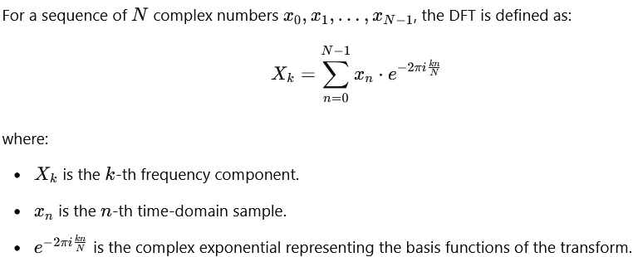

Recap: Discrete Fourier Transform
Quantum Computing Group
The Discrete Fourier Transform is a mathematical technique used to transform a sequence of complex numbers into another sequence of complex numbers, representing the original sequence in the frequency domain.
This transformation helps analyze the frequency components of the signal, which is useful in various applications such as signal processing, image analysis, and data compression.

Slide 5
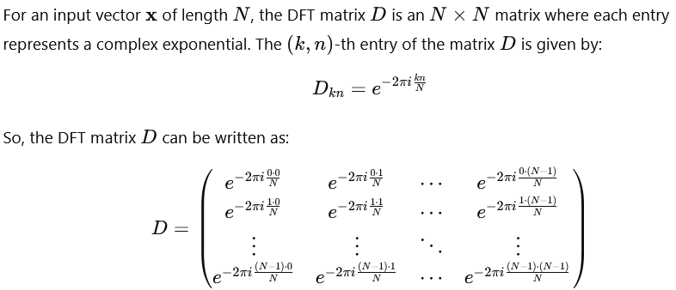
DFT Matrix Representation
Quantum Computing Group

Slide 6
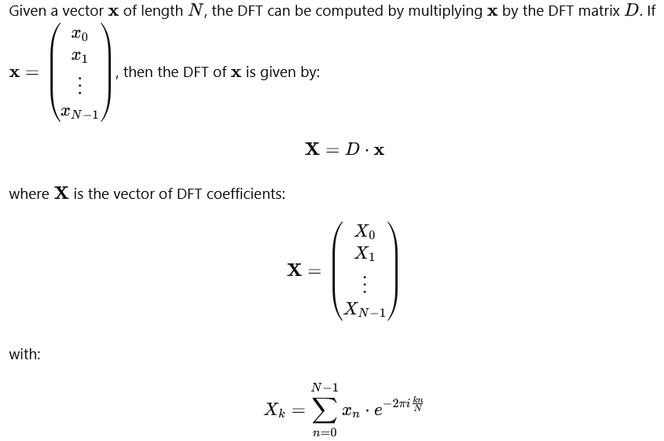
Quantum Computing Group

Slide 7
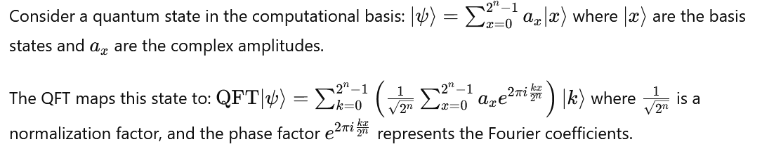
QFT: Mathematical Formulation
Quantum Computing Group

Slide 8
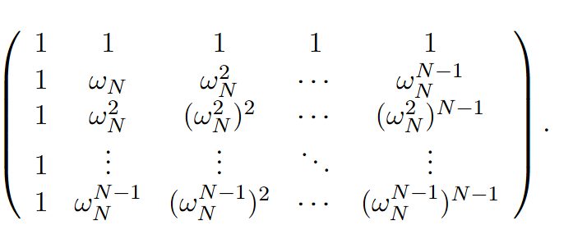

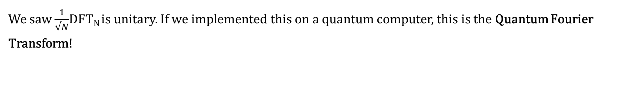
QFT_{N}
Quantum Computing Group
We saw $\frac{1}{√N}$DFT_{N} is unitary. If we implemented this on a quantum computer, this is the Quantum Fourier Transform!
$$\frac{1}{√N}$$
QFT_{N}=

Slide 9
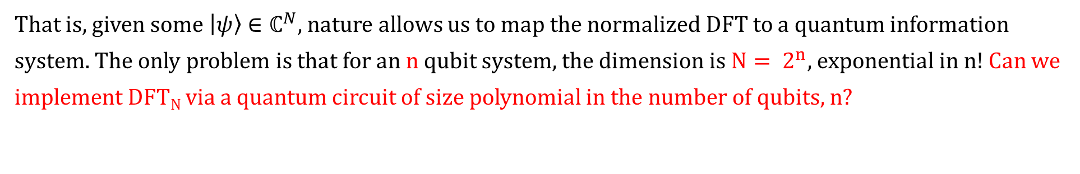
QFT_{N}
Quantum Computing Group
We saw $\frac{1}{√N}$DFT_{N} is unitary. If we implemented this on a quantum computer, this is the Quantum Fourier Transform!
$$\frac{1}{√N}$$
QFT_{N}=
That is, given some $\left|ψ\right\rangle ∈ℂ^{N}$, nature allows us to map the normalized DFT to a quantum information system. The only problem is that for an n qubit system, the dimension is ${N= 2}^{n}$, exponential in n! Can we implement DFT_{N} via a quantum circuit of size polynomial in the number of qubits, n?

Slide 10
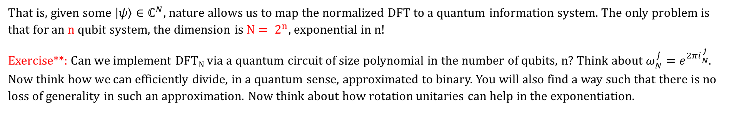
QFT_{N}
Quantum Computing Group
We saw $\frac{1}{√N}$DFT_{N} is unitary. If we implemented this on a quantum computer, this is the Quantum Fourier Transform!
$$\frac{1}{√N}$$
QFT_{N}=
That is, given some $\left|ψ\right\rangle ∈ℂ^{N}$, nature allows us to map the normalized DFT to a quantum information system. The only problem is that for an n qubit system, the dimension is ${N= 2}^{n}$, exponential in n!
Exercise**: Can we implement DFT_{N} via a quantum circuit of size polynomial in the number of qubits, n? Think about $ω_{N}^{j}=e^{2πi\frac{j}{N}}$. Now think how we can efficiently divide, in a quantum sense, approximated to binary. You will also find a way such that there is no loss of generality in such an approximation. Now think about how rotation unitaries can help in the exponentiation.

Slide 11
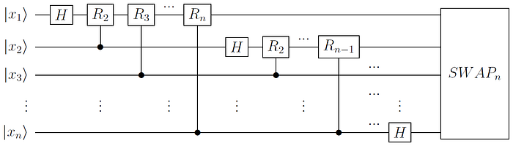
Efficient Implementation of QFT_{N}
Quantum Computing Group
The circuit implementation of QFT is as follows:

Slide 12
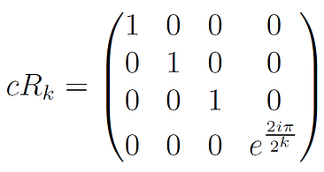
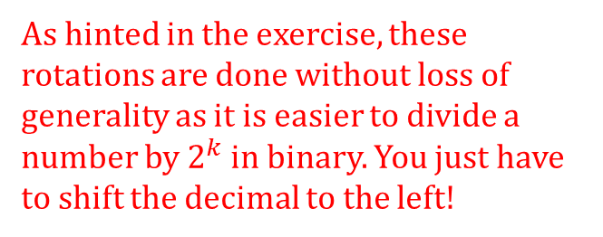
Efficient Implementation of QFT_{N}
Quantum Computing Group
The Hadamard gates take the inputs into equal superposition. From here try to intuit why we have the normalization term.
The circuit implementation of QFT is as follows:
{
The SWAP gate is there because the QFT is calculated as an MSB priority. To switch it back to LSB we use this swap.
n qubits
As hinted in the exercise, these rotations are done without loss of generality as it is easier to divide a number by $2^{k}$ in binary. You just have to shift the decimal to the left!
The controlled rotations

Slide 13
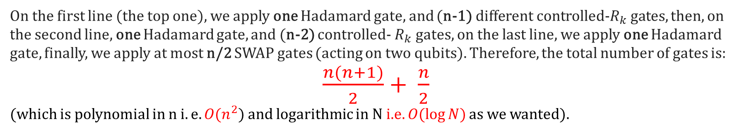
Efficient Implementation of QFT_{N}
Quantum Computing Group
Now we ask ourselves, is this implementation really efficient?
{
n qubits
On the first line (the top one), we apply one Hadamard gate, and (n-1) different controlled-$R_{k}$ gates, then, on the second line, one Hadamard gate, and (n-2) controlled- $R_{k}$gates, on the last line, we apply one Hadamard gate, finally, we apply at most n/2 SWAP gates (acting on two qubits). Therefore, the total number of gates is:
$\frac{n(n+1)}{2}+ \frac{n}{2}$
(which is polynomial in n $i.e. O(n^{2})$ and logarithmic in N i.e. $O(\log{N})$ as we wanted).

Slide 14
QFT_{N}- Getting our hands dirty
Quantum Computing Group
The QFT is an analogue of the DFT. But what does it really do?

Slide 15
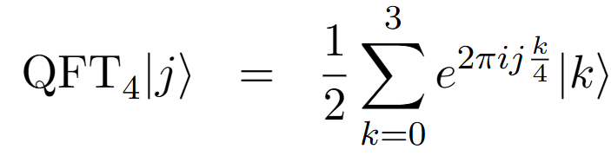
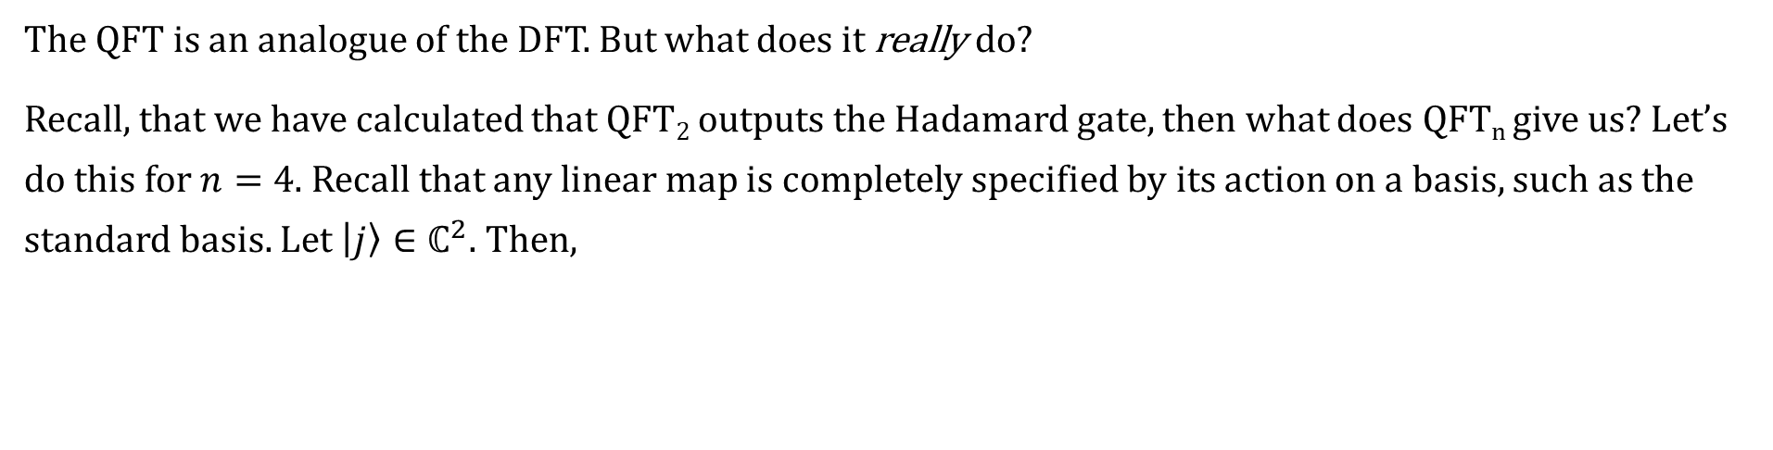
QFT_{N}- Getting our hands dirty
Quantum Computing Group
The QFT is an analogue of the DFT. But what does it really do?
Recall, that we have calculated that QFT₂ outputs the Hadamard gate, then what does QFT_{n} give us? Let’s do this for $n=4$. Recall that any linear map is completely specified by its action on a basis, such as the standard basis. Let $\left|j\right\rangle ∈ℂ^{2}$. Then,
where we have intentionally grouped k/4 together for the following reason. Binary division, i.e. division by $2^{k}$ is cheap, as we need to shift the decimal to the left by k positions.

Slide 16
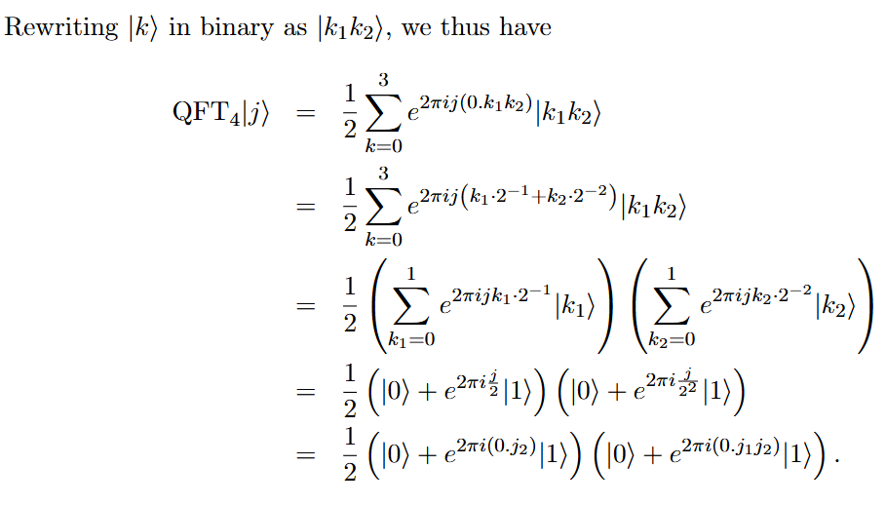
QFT_{N}- Getting our hands dirty
Quantum Computing Group

Slide 17

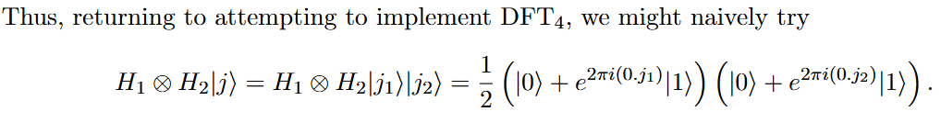
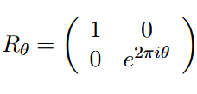
QFT_{N}- Getting our hands dirty
Quantum Computing Group
So, from the previous slide, we had the following:
Now comes the key observation: Applying the Hadamard to single qubit standard basis state yields:
This is almost what we want (up to swapping the two output registers), except we are missing the bit $j_{2}$in the phase $\exp\left(2πi\left(0.j_{1}j_{2}\right)\right).$ Inserting a phase θ ∈ $ℝ$, however, is easily accomplished by:

Slide 18

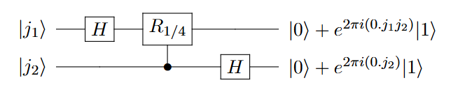
QFT_{N}- Getting our hands dirty
Quantum Computing Group
Note that we want to get the following expression:
Using Hadamard gates, we have this:
But using the rotation gate below, in order to insert phase exp(2πi(0.0j2)) into the first term(and hence first qubit), we must have our rotation gate to depend on the second qubit.
Therefore, by using a controlled rotation, we have

Slide 19
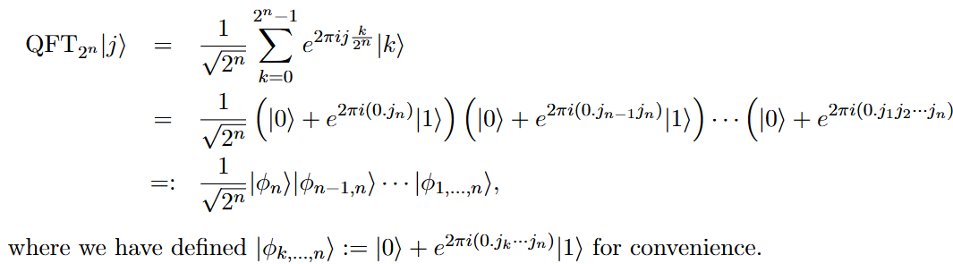

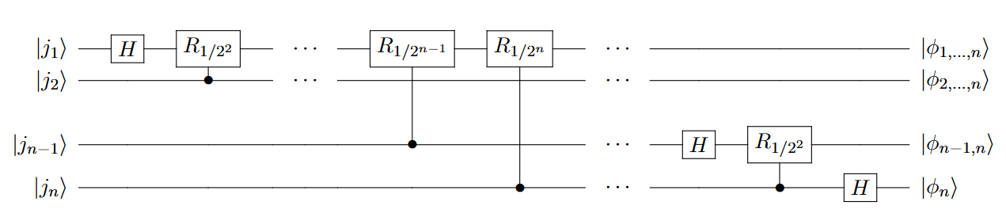
QFT_{N}- Getting our hands dirty
Quantum Computing Group
This leads to the general circuit as follows:

Slide 20
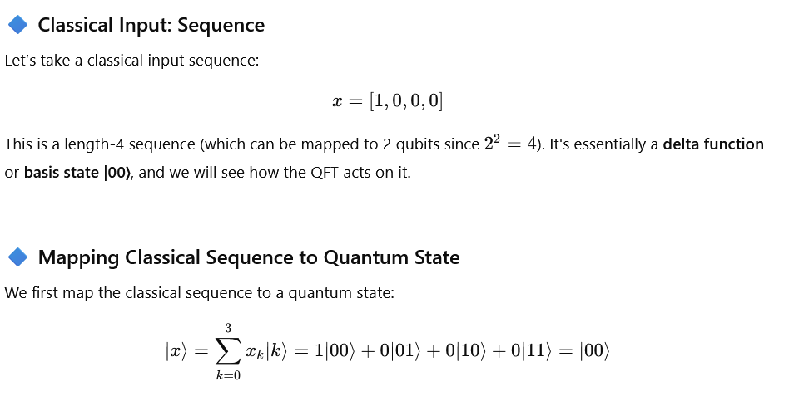
An Example

Slide 21
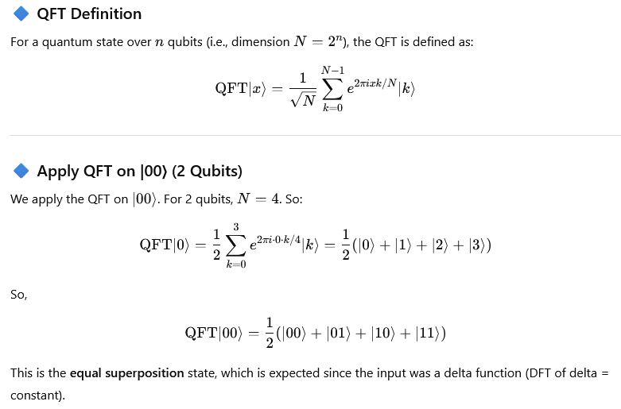

Slide 22
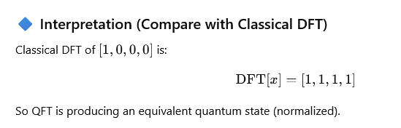

Slide 23
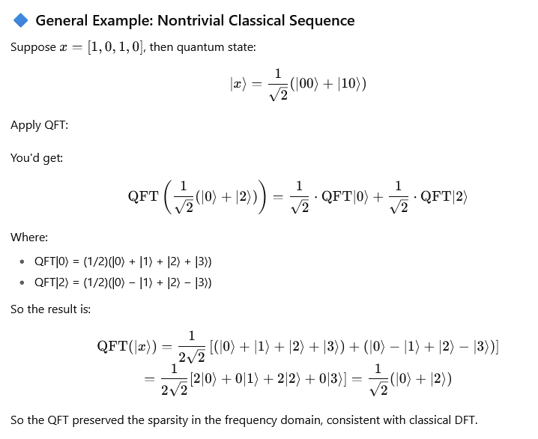

Slide 24
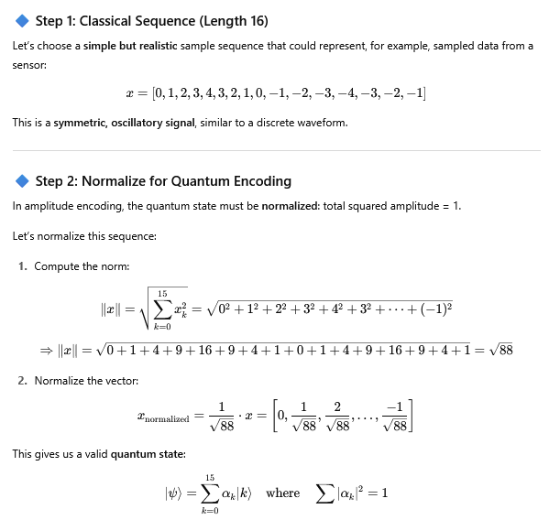

Slide 25
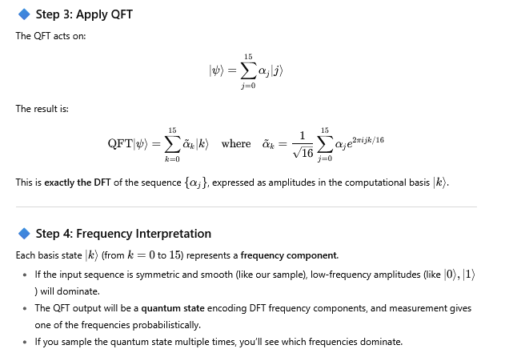

Slide 26
QUANTUM PHASE ESTIMATION
Quantum Computing Group
An application of QFT

Slide 27
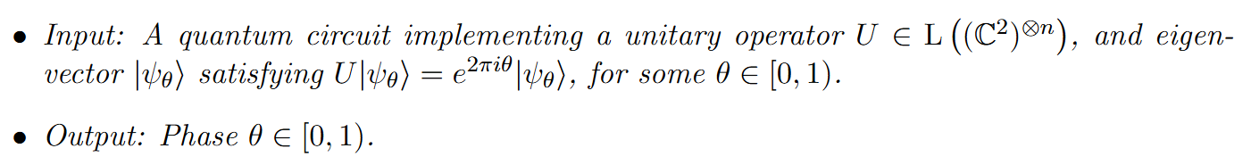
QPE- Why should we care?
Quantum Computing Group
Now that we know the inner workings of QFT, we can easily put it in action in the form of QPE. This algorithm can be described as follows:

Slide 28
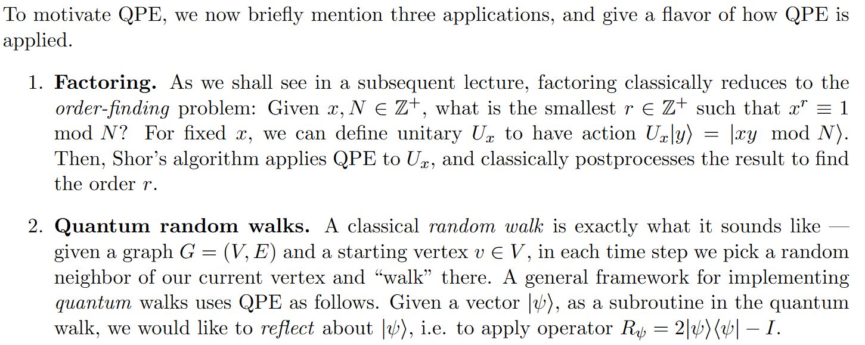
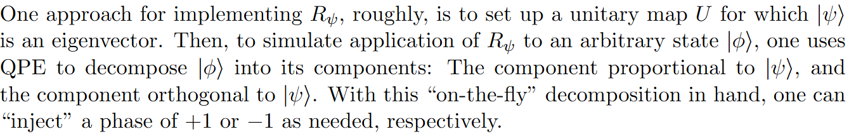
QPE- Some Applications
Quantum Computing Group

Slide 29
QPE- Some Applications
Quantum Computing Group
Does this operator look familiar?

Slide 30
QPE- How it works
Quantum Computing Group
Recall that:

Slide 31

QPE- How it works
Quantum Computing Group
This is a little bit more involved, but follows directly from the first case, and therefore is left as an exercise!

Slide 32
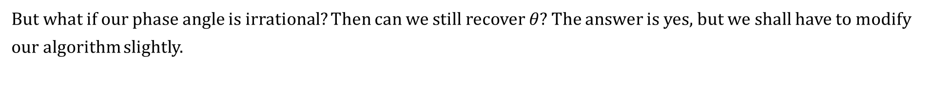
QPE- How it works
Quantum Computing Group
But what if our phase angle is irrational? Then can we still recover $θ$? The answer is yes, but we shall have to modify our algorithm slightly.

Slide 33
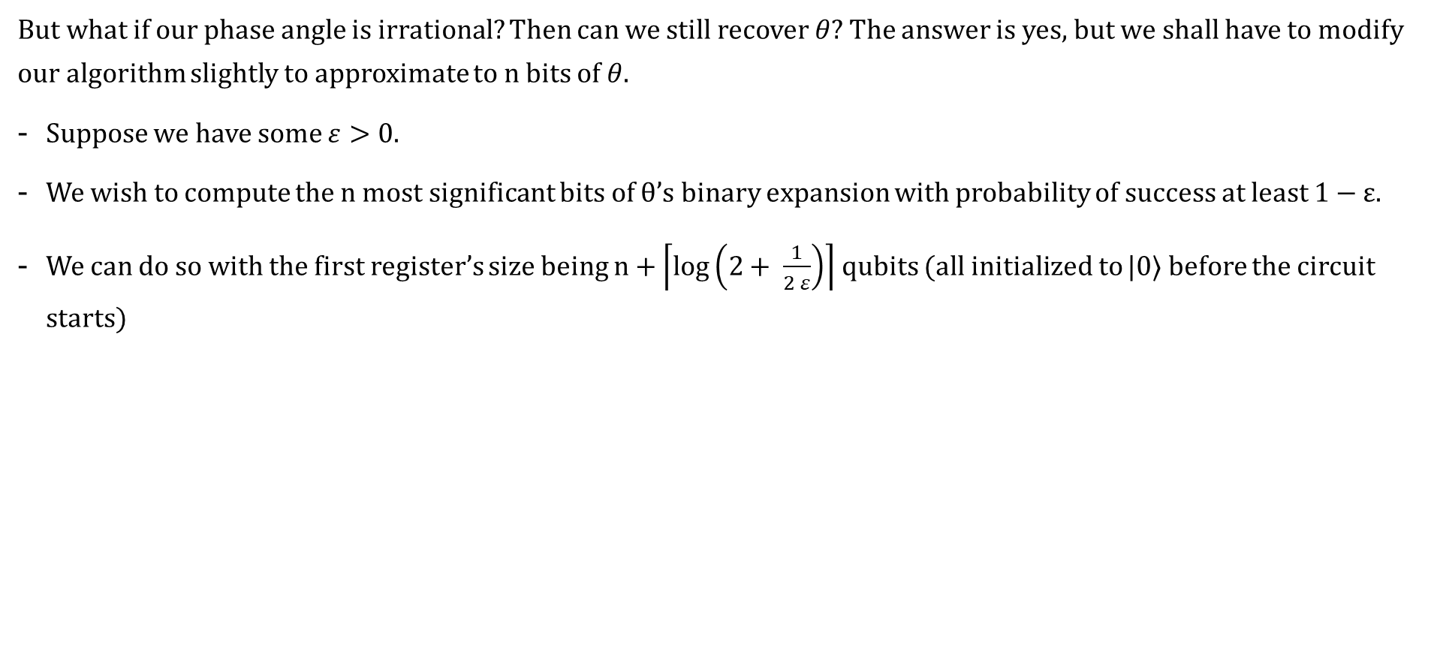
QPE- How it works
Quantum Computing Group
But what if our phase angle is irrational? Then can we still recover $θ$? The answer is yes, but we shall have to modify our algorithm slightly to approximate to n bits of $θ$.
Suppose we have some $ε>0.$
We wish to compute the n most significant bits of θ’s binary expansion with probability of success at least 1 − ε.
We can do so with the first register’s size being $n+\left\lceil \left.\log\left(2+ \frac{1}{2 ε}\right)\right\rceil \right.$ qubits (all initialized to |0⟩ before the circuit starts)

Slide 34
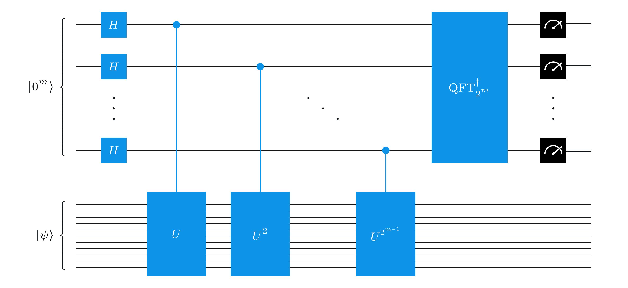
QPE- Bringing it together
Quantum Computing Group

Slide 35
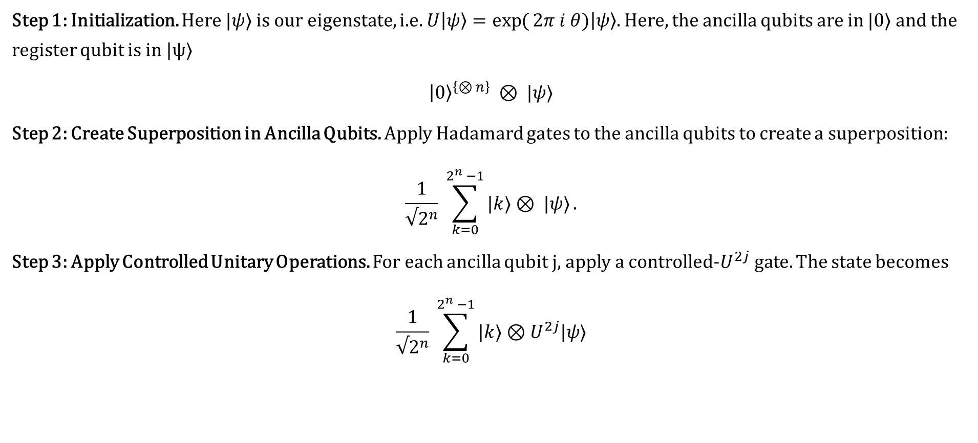
QPE- Getting our hands dirty
Quantum Computing Group
Step 1: Initialization. Here $|ψ⟩$ is our eigenstate, i.e. $U\left|ψ\right\rangle =\exp{(}2π i θ)\left|ψ\right\rangle .$ Here, the ancilla qubits are in |0⟩ and the register qubit is in |ψ⟩
${\left|0\right\rangle }^{\left\{⊗ n\right\}} ⊗ |ψ⟩$
Step 2: Create Superposition in Ancilla Qubits. Apply Hadamard gates to the ancilla qubits to create a superposition:
$$\frac{1}{√2^{n}} \sum_{k=0}^{2^{n} −1}{|k⟩⊗ |ψ⟩}.$$
Step 3: Apply Controlled Unitary Operations. For each ancilla qubit j, apply a controlled-$U^{2j}$gate. The state becomes
$$\frac{1}{√2^{n}} \sum_{k=0}^{2^{n} −1}{|k⟩⊗U^{2j}|ψ⟩}$$

Slide 36
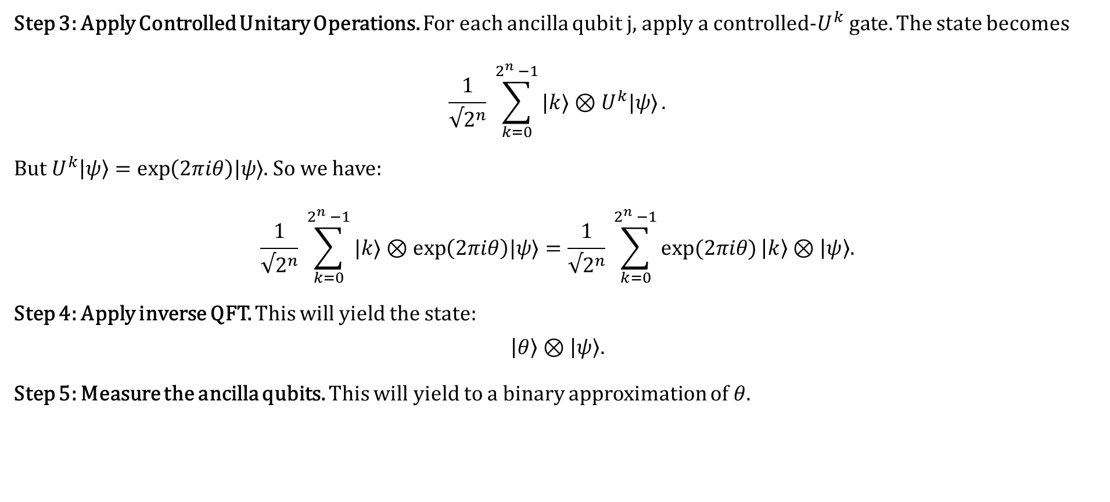
QPE- Getting our hands dirty
Quantum Computing Group
Step 3: Apply Controlled Unitary Operations. For each ancilla qubit j, apply a controlled-$U^{k}$gate. The state becomes
$$\frac{1}{√2^{n}} \sum_{k=0}^{2^{n} −1}{|k⟩⊗U^{k}|ψ⟩}.$$
But $U^{k}\left|ψ\right\rangle =\exp\left(2πiθ\right)|ψ⟩$. So we have:
$$\frac{1}{√2^{n}} \sum_{k=0}^{2^{n} −1}{|k⟩⊗\exp\left(2πiθ\right)|ψ⟩}=\frac{1}{√2^{n}} \sum_{k=0}^{2^{n} −1}{\exp{(2πiθ)}\left|k\right\rangle ⊗\left|ψ\right\rangle .}$$
Step 4: Apply inverse QFT. This will yield the state:
$$\left|θ\right\rangle ⊗\left|ψ\right\rangle .$$
Step 5: Measure the ancilla qubits. This will yield to a binary approximation of $θ$.

Slide 37
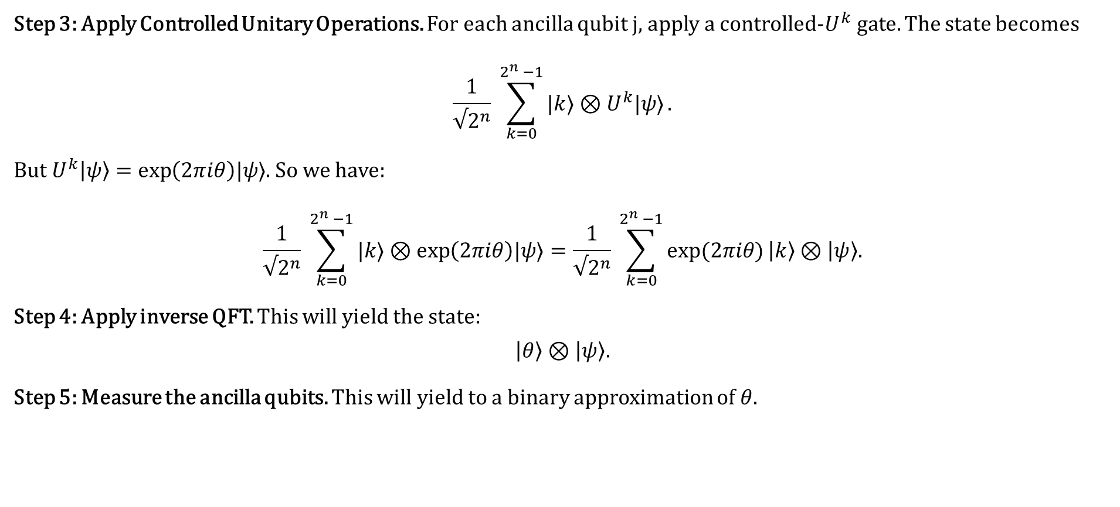
QPE- Getting our hands dirty
Quantum Computing Group
Step 3: Apply Controlled Unitary Operations. For each ancilla qubit j, apply a controlled-$U^{k}$gate. The state becomes
$$\frac{1}{√2^{n}} \sum_{k=0}^{2^{n} −1}{|k⟩⊗U^{k}|ψ⟩}.$$
But $U^{k}\left|ψ\right\rangle =\exp\left(2πiθ\right)|ψ⟩$. So we have:
$$\frac{1}{√2^{n}} \sum_{k=0}^{2^{n} −1}{|k⟩⊗\exp\left(2πiθ\right)|ψ⟩}=\frac{1}{√2^{n}} \sum_{k=0}^{2^{n} −1}{\exp{(2πiθ)}\left|k\right\rangle ⊗\left|ψ\right\rangle .}$$
Step 4: Apply inverse QFT. This will yield the state:
$$\left|θ\right\rangle ⊗\left|ψ\right\rangle .$$
Step 5: Measure the ancilla qubits. This will yield to a binary approximation of $θ$.

Slide 38
QPE- Getting our hands dirty
Quantum Computing Group
Step 3: Apply Controlled Unitary Operations. For each ancilla qubit j, apply a controlled-$U^{k}$gate. The state becomes
$$\frac{1}{√2^{n}} \sum_{k=0}^{2^{n} −1}{|k⟩⊗U^{k}|ψ⟩}.$$
But $U^{k}\left|ψ\right\rangle =\exp\left(2πiθ\right)|ψ⟩$. So we have:
$$\frac{1}{√2^{n}} \sum_{k=0}^{2^{n} −1}{|k⟩⊗\exp\left(2πiθ\right)|ψ⟩}=\frac{1}{√2^{n}} \sum_{k=0}^{2^{n} −1}{\exp{(2πiθ)}\left|k\right\rangle ⊗\left|ψ\right\rangle .}$$
Step 4: Apply inverse QFT. This will yield the state:
$$\left|θ\right\rangle ⊗\left|ψ\right\rangle .$$
Step 5: Measure the ancilla qubits. This will yield to a binary approximation of $θ$.

Slide 39

QPE- A Chemistry Application
Quantum Computing Group
In this example, we are given a Hermitian matrix H, which corresponds to the total energy of a multibody system. We will see how QPE can find the eigenvector corresponding to the least eigenvalue. This is analogous to finding the ground state of the system (i.e. of an molecule, etc.)
Define the Hamiltonian H for a system
Prepare a trial quantum state |ψ⟩ that has overlap with the ground state
Construct the unitary operator U = exp(−iHt) for a chosen time t
NO
Check if E corresponds to the ground state energy
Measure the phase ϕ to estimate the eigenvalue E corresponding to |ψ⟩
Apply QuantumPhase Estimation to U using |ψ⟩
Yes
$$E is the ground state energy$$

Slide 40
Thank You
?

